Slide 1


Quincy Mine
Drill & Blacksmith Shop
Eagle Nest Consulting Group
Reid Grunewald, Rayni Brill, Ryan Brown, and Connor Laﬀerty

Slide 2



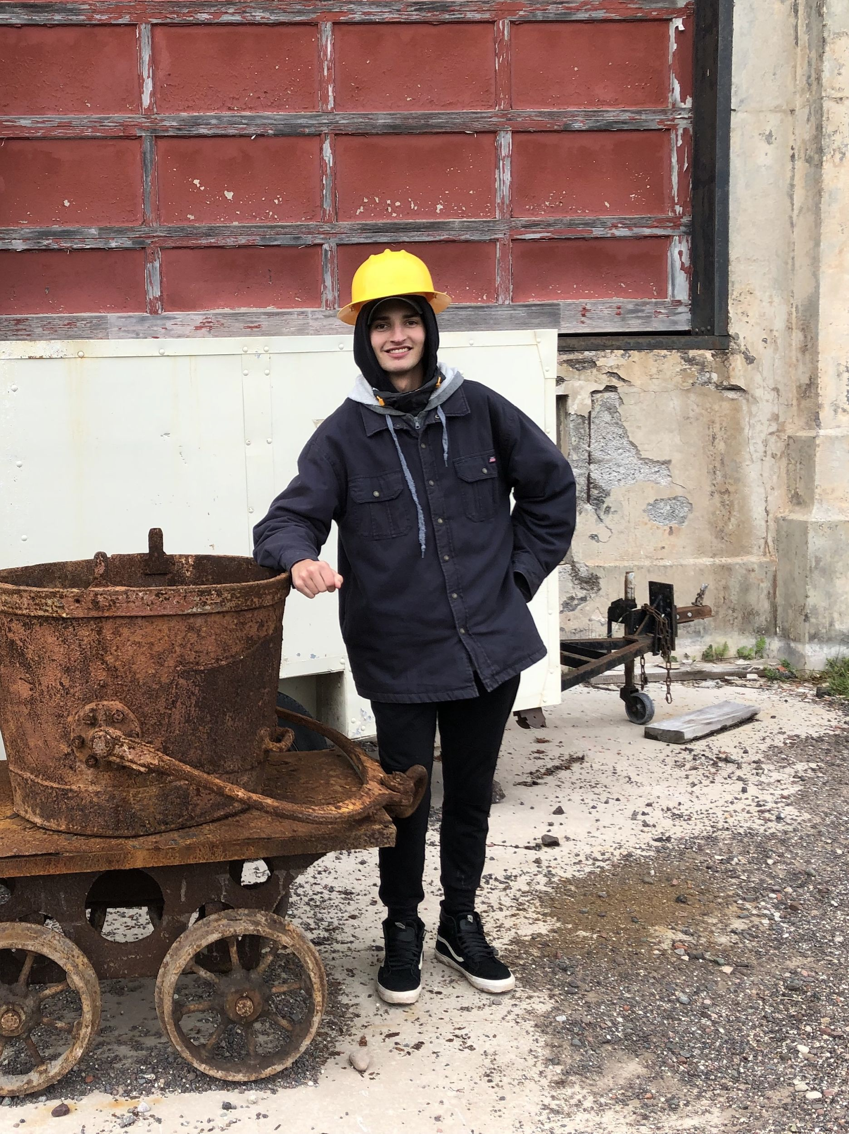
Our Team:
Reid Grunewald
Rayni Brill
Ryan Brown
Connor Laﬀerty

Slide 3
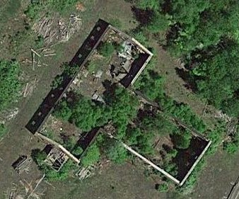
Introduction
Location: Near Hancock, MI
Client: The Quincy Mine Hoist Association
Objective:
  Historically Accurate
  Enclosed
  More suitable for tours
Plan view of current Drill & Blacksmith Shop
Rayni

Slide 4
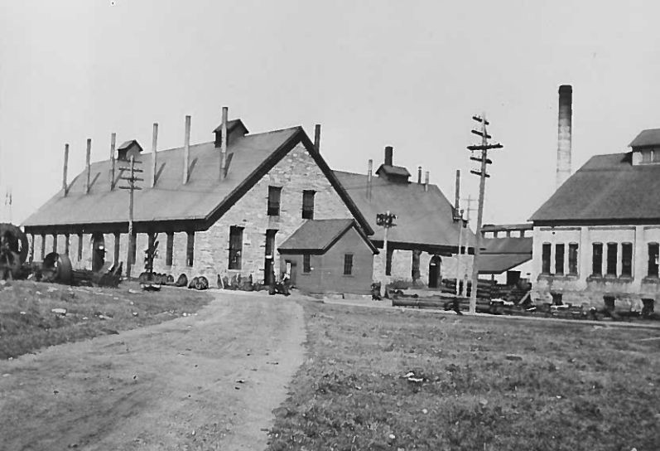
Background
Quincy Mine: In operation from 1846-1945.
Earliest documentation: 1900.
Original Building:
  Portage Entry Sandstone Walls
  Slate Shingle Roof
  Thirty-Nine Windows
  Six Main Doors
  Oﬃce
  Loft
Rayni

Slide 5
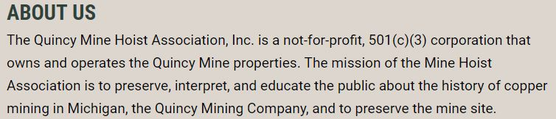
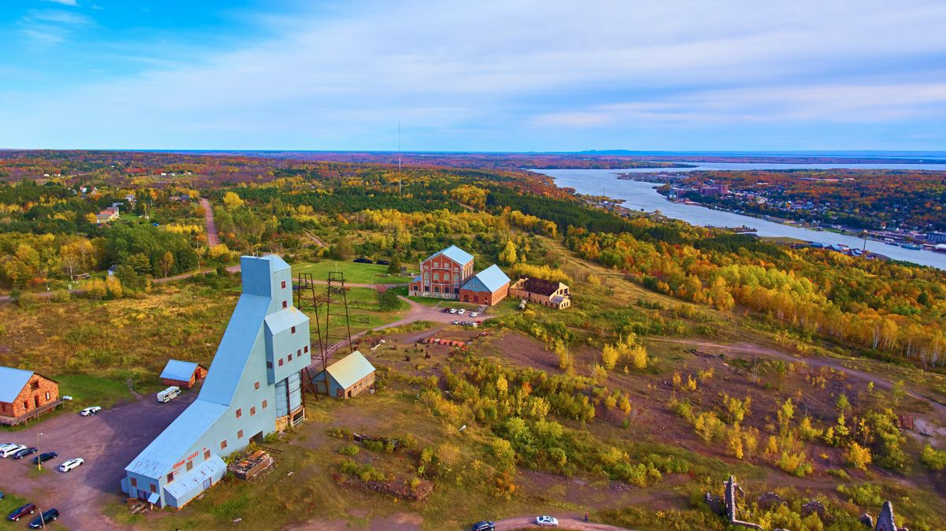
Background
The Quincy Mine Hoist Association:
  Oﬀers tours
  Preserve & educate
Rayni

Slide 6
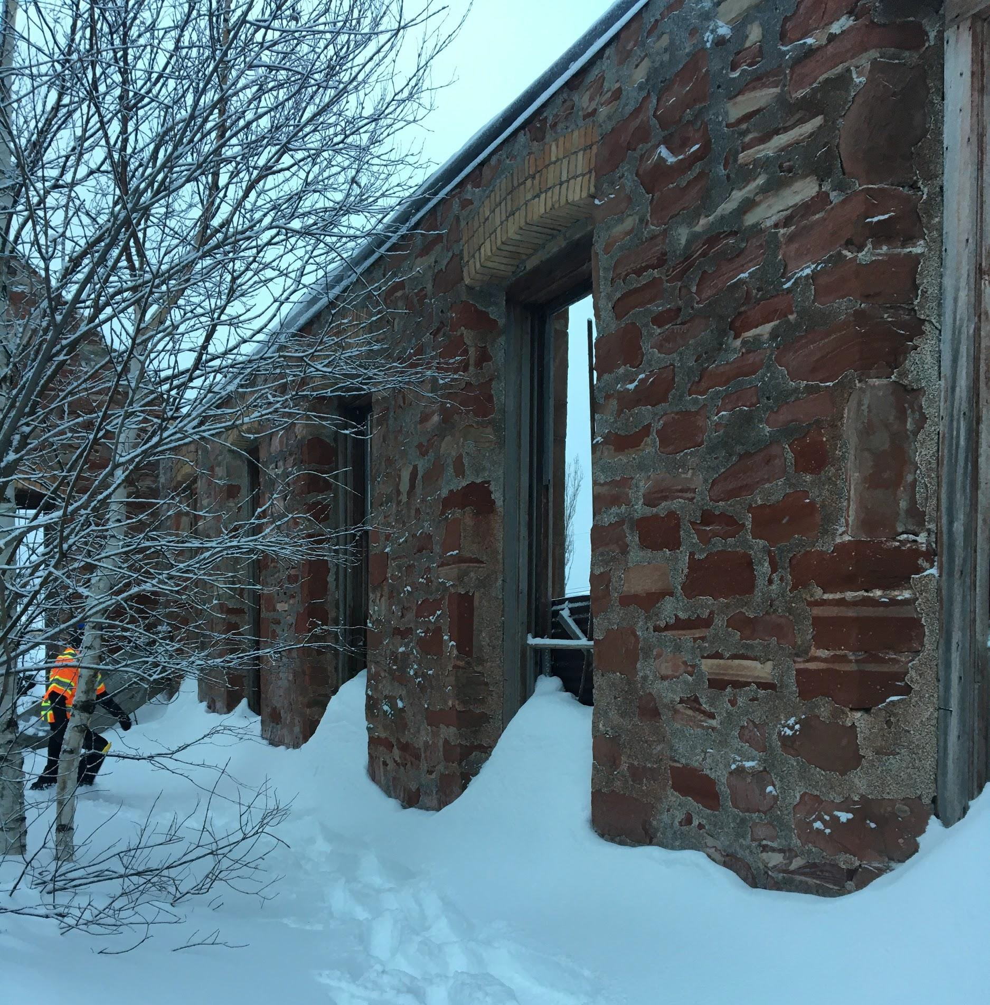
Existing Site Conditions
No roof or ﬂoor.
Windows and doors in poor condition.
Trees and plants inside the walls.
Machinery.
Current interior of the northwest side of the Drill & Blacksmith Shop
Reid

Slide 7
Client Constraints
Cost:
Should be as cost eﬃcient as possible.
  A “not-for-proﬁt” organization.
A preliminary cost estimate.
Historical Conditions:
Historically accurate
Expensive
No longer produced
Alternate solutions have been discussed.
Rayni

Slide 8
Site Constraints
Currently, there is no nearby parking lot owned by the client; therefore a temporary lot will need to be installed for construction purposes
Temporary lot will be constructed in the location of the permanent parking lot with access oﬀ of Lower Pewabic Road.
Due to the speed and Capacity of US 41, the temporary lot will be constructed early on during the construction process for ease of deliveries and material storage.
Towards the end of the construction process, the temporary lot will be paved and transformed into the permanent parking lot.
Connor

Slide 9

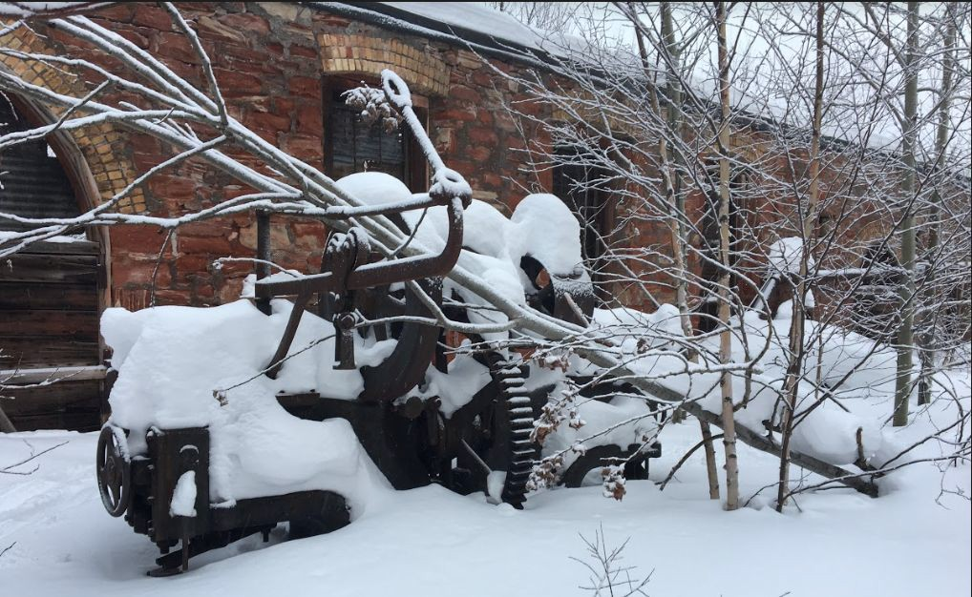
Site Clearing
Clearing will be performed inside the structure and along the wall to allow the crane to move the beams.
Tree removal will be diﬃcult in some areas because they are entangled with the machinery.
  Small vehicles may enter the front door.
Ryan

Slide 10
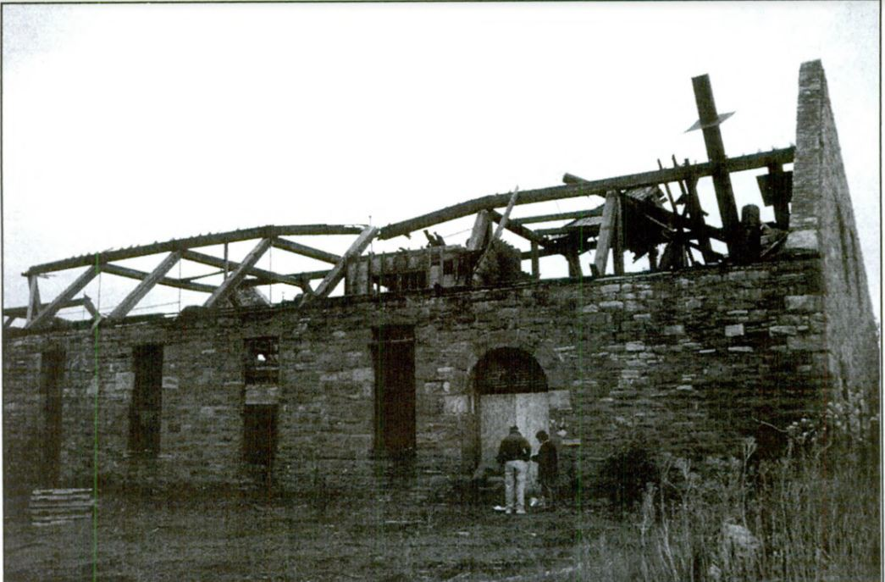
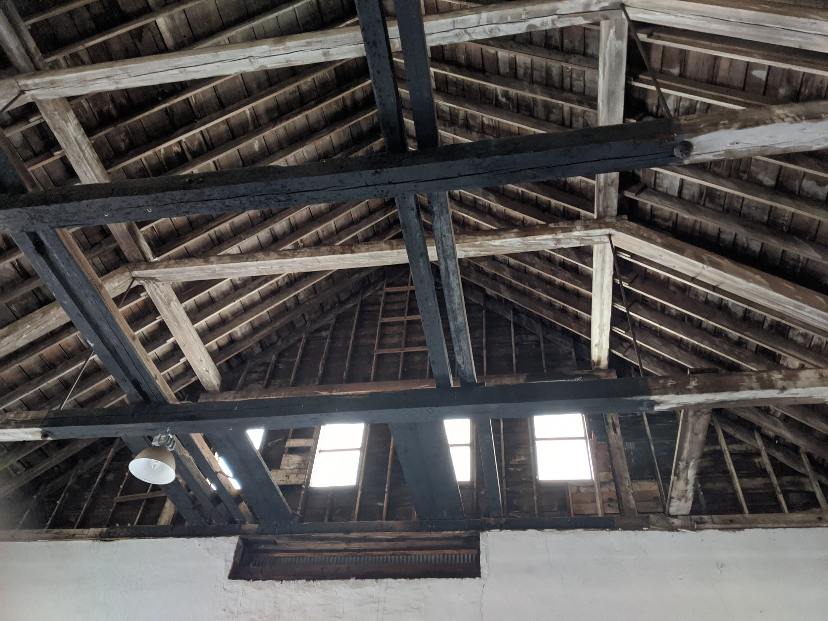
Roof Truss Design
The truss design for the Drill and Blacksmith Shop is the same as the trusses in the 1894 Hoist House, but on a diﬀerent scale.
Reid

Slide 11
Roof Truss Design
Above the loft, the trusses are diﬀerent in that the steel members are replaced with timber columns and there are probably no spanning bottom chords.
Reid

Slide 12
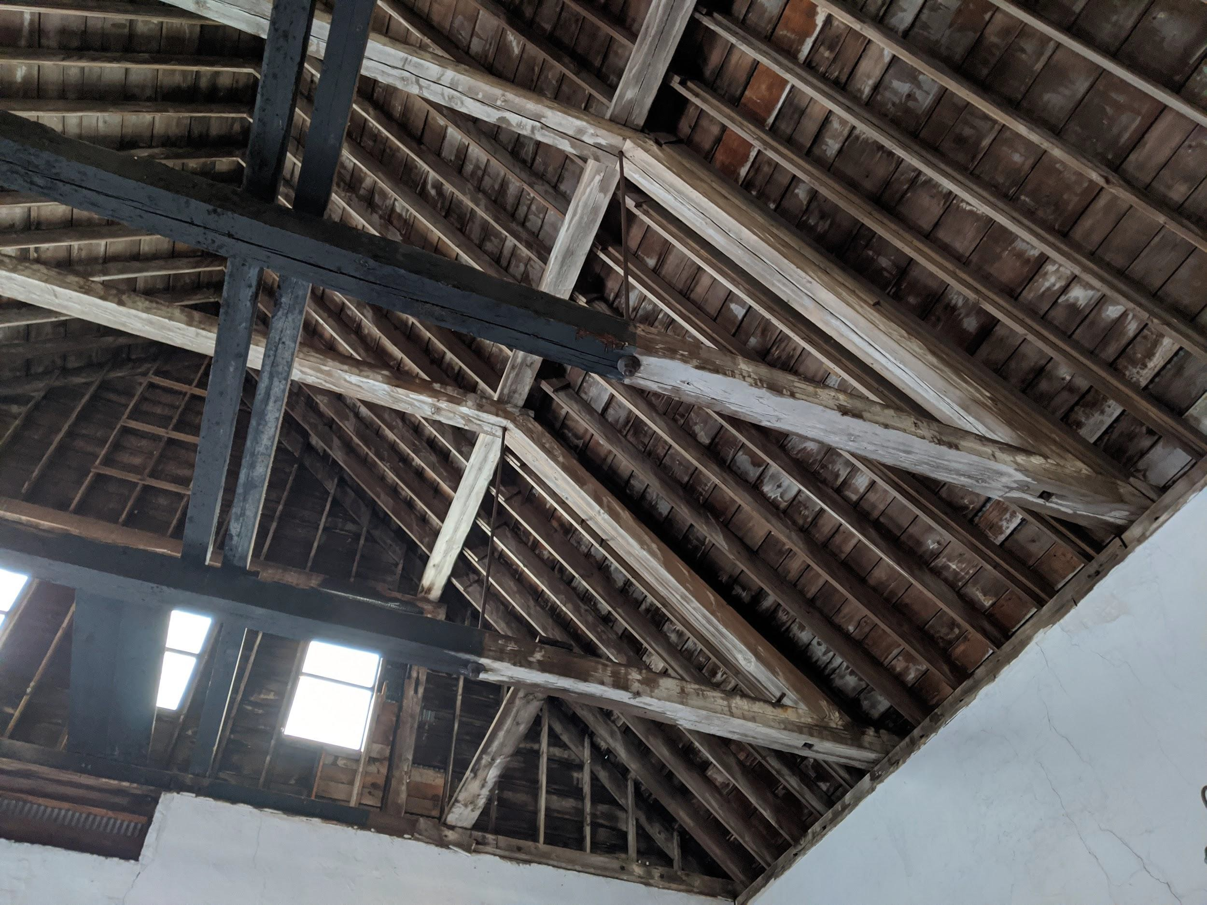
Roof Truss Design
The roof purlins are supported at 4 points by the trusses.
Reid

Slide 13
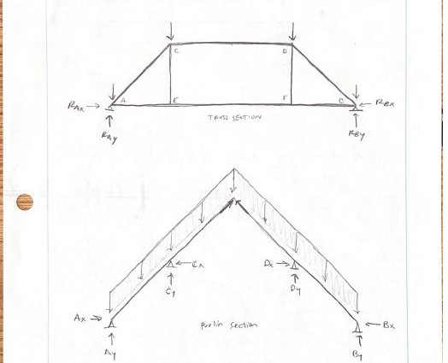
Roof Truss Design
Since the spans of the truss are so large, we decided to use
glued-laminated timber beams. They can be found in the correct dimensions (12”x12”) and length (max. 50’), and they have a large moment capacity to handle the long span without excessive deformation.
50 ft
Reid

Slide 14
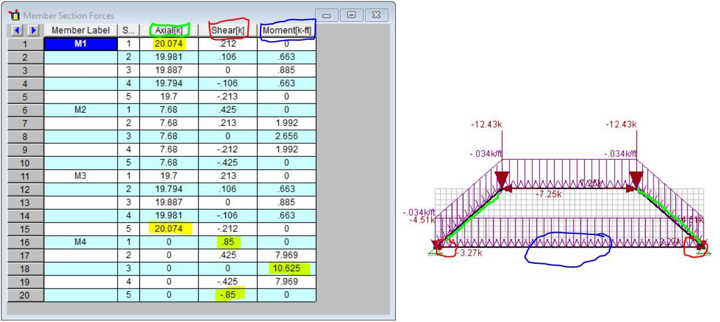
Roof Truss Design
Truss analysis calculations were done by hand and then those values were entered into RISA-2D for analysis.
Reid

Slide 15
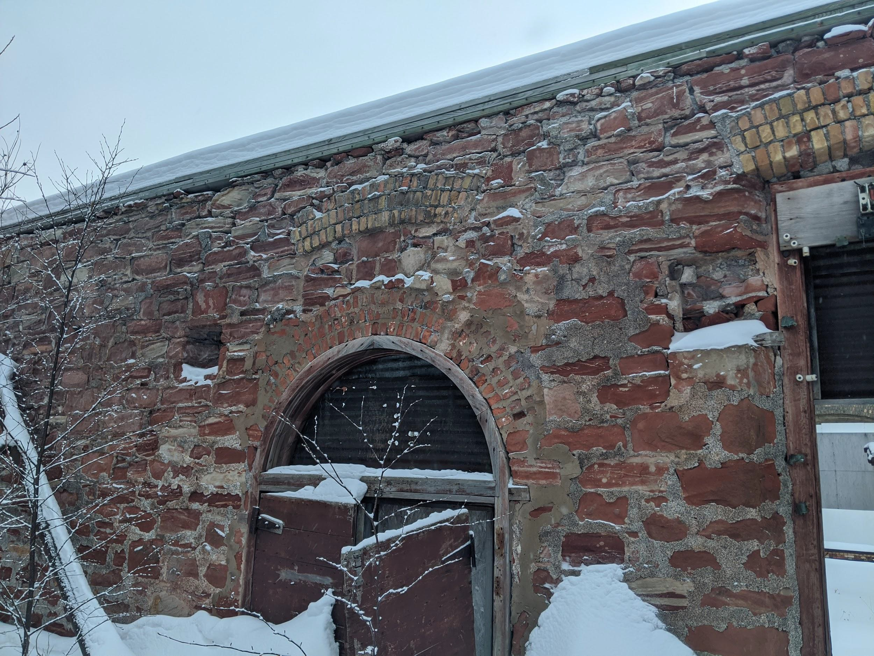
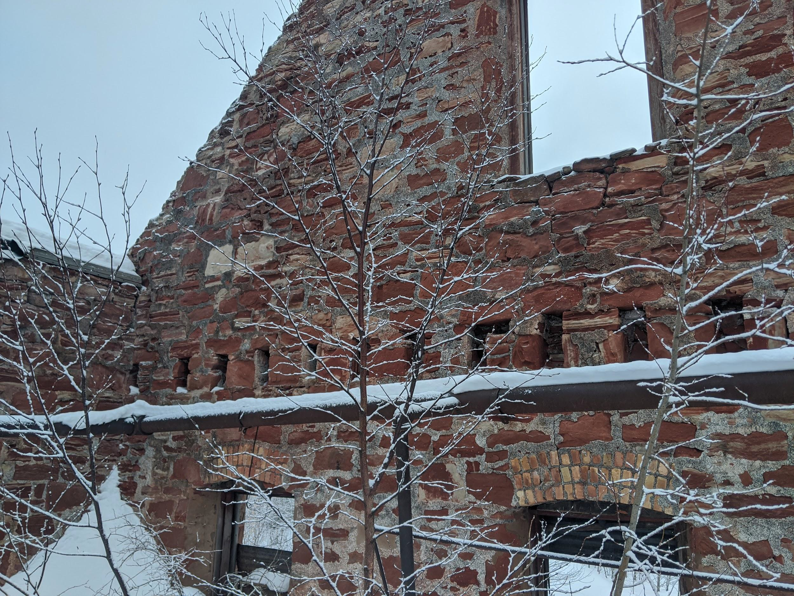
Loft Design
The loft was designed based on archival blueprints and existing “cutouts” in the structure’s walls. The sandstone wall has 24 rectangular slots along the east wall and two square slots on each side of the adjacent walls.
Reid

Slide 16
Loft Design
The loft was designed based on archival blueprints and existing “cutouts” in the structure’s walls. The sandstone wall has 24 rectangular slots along the east wall and two square slots on each side of the adjacent walls.
Reid

Slide 17
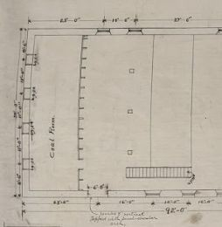
Loft Design
The beams supporting the ﬂoor joists are supported by three columns in the blueprints. However, in order to support the ﬂooring and required loads from ASCE 7, we recommend using four or ﬁve columns. This drawing also does not show the columns under the middle beam, located 16’ from the east wall. All measurements are approximate due to lack of access to the job site.
Reid

Slide 18
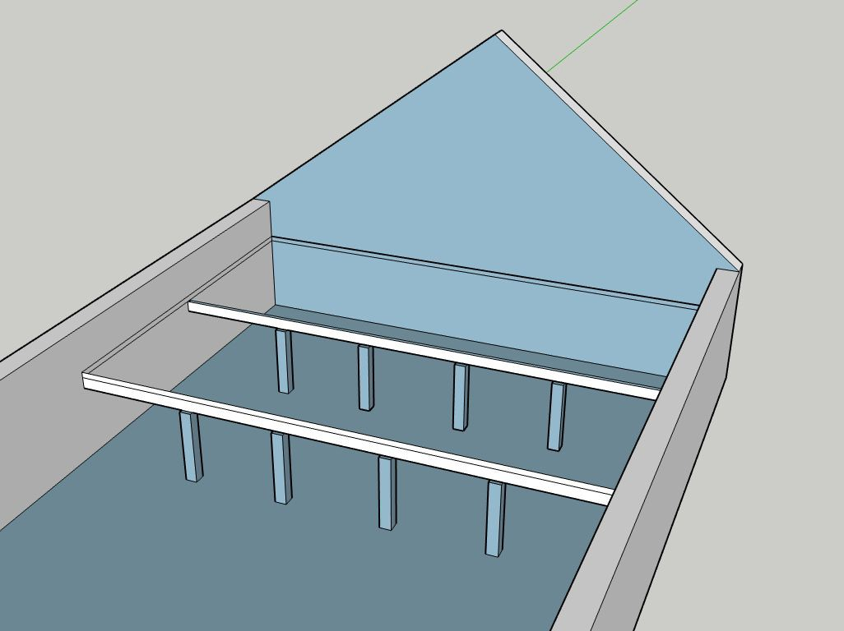
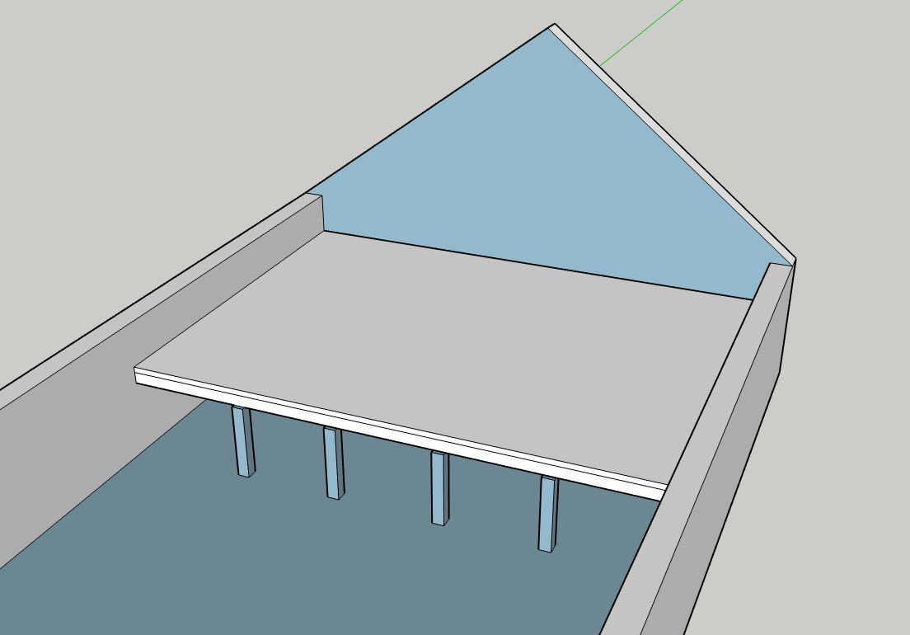
Loft Design
Reid

Slide 19
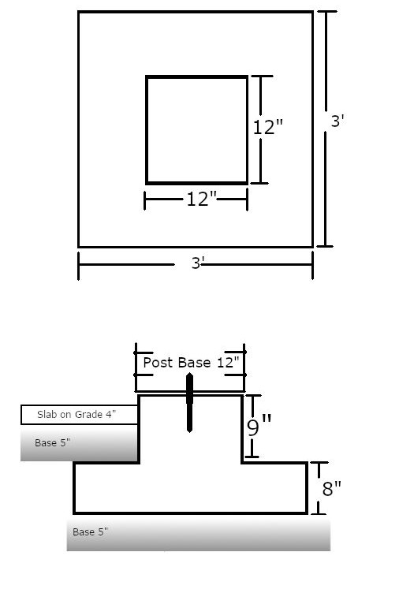
Loft Footings
Each columns carry 30 kips
Assuming a bearing capacity of 4 kips per square foot the footings carry 36 kips
Ryan

Slide 20
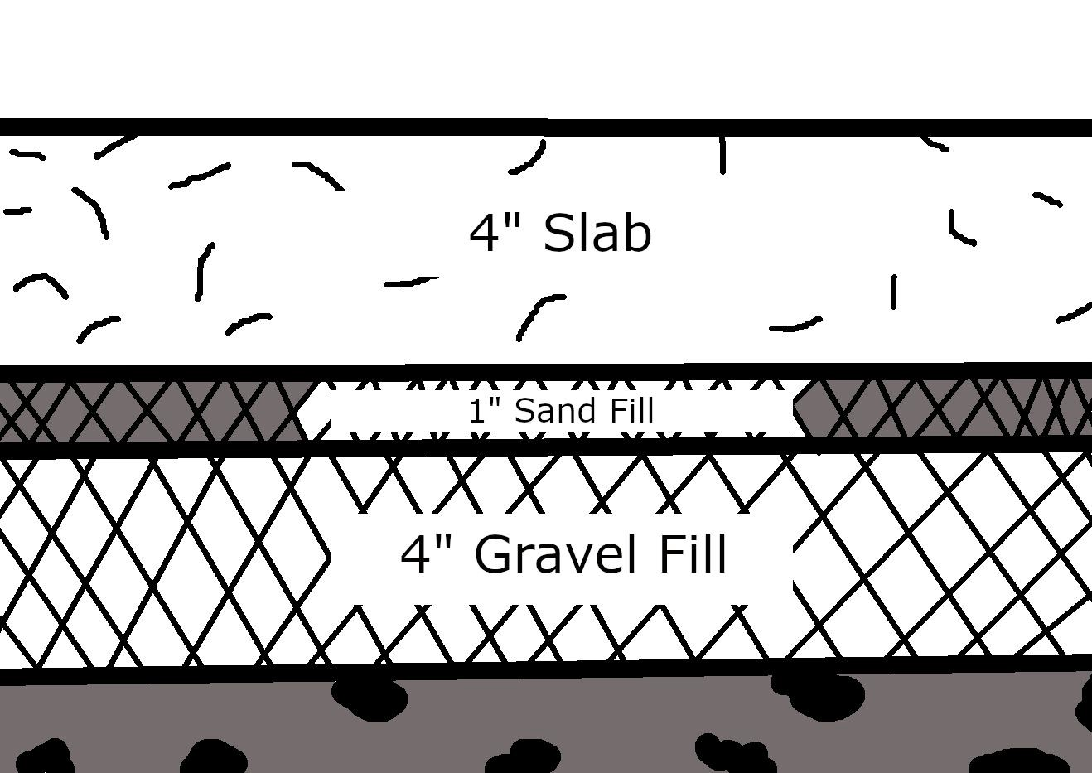
Base
Following the guidelines of ACI report 360-10 the base will consist of 4 inches of gravel and 1 inch of sand.
The base increases soil capacity and drainage.
Ryan

Slide 21
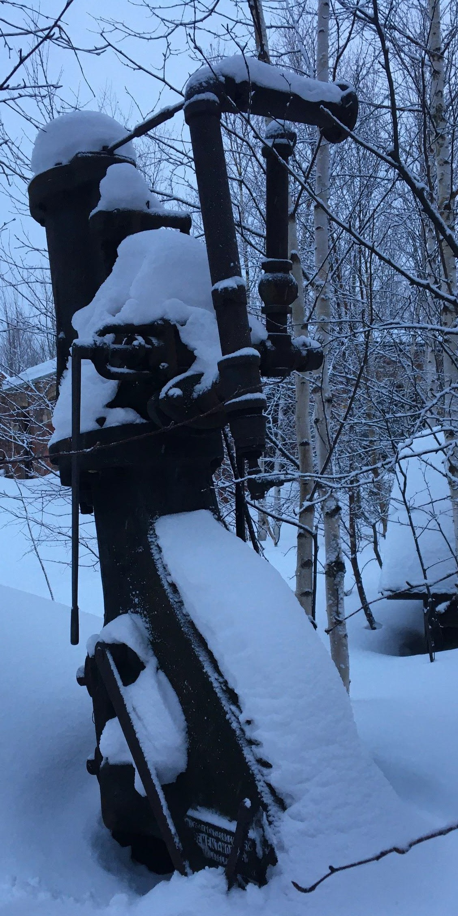
Slab Design
The slab is 4” thick, has compressive strength of 3500 psi, and a steel ﬁber additive.
Design criteria was determined by the shear force of the machinery.
The heaviest machine is approximately 2000 lbs, while its base could allow 51,000 lbs
Reducing the thickness is not worth the risk.
Ryan

Slide 22
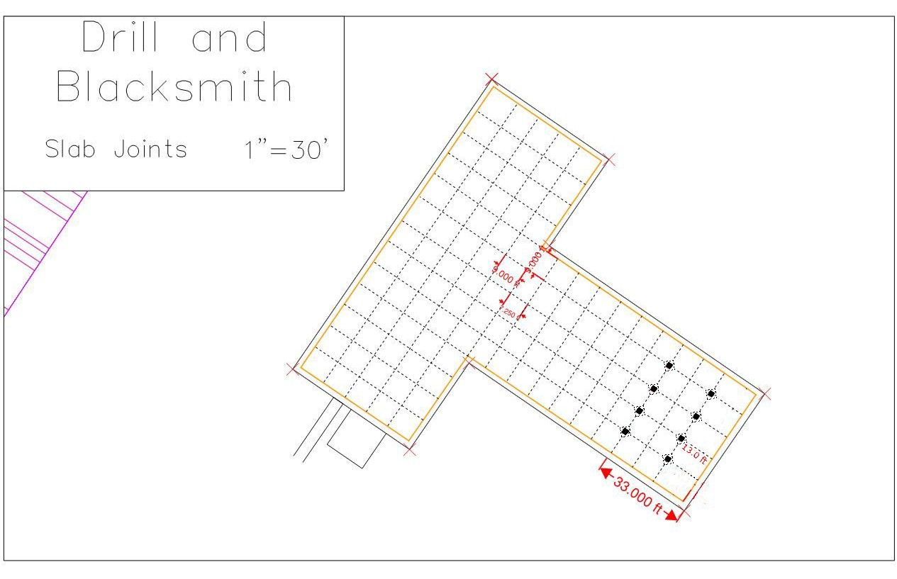
Slab Construction
Concrete will be poured through the windows with pump truck
9’X9’ 1” saw cuts
Pond cure for 8 days
Ryan

Slide 23
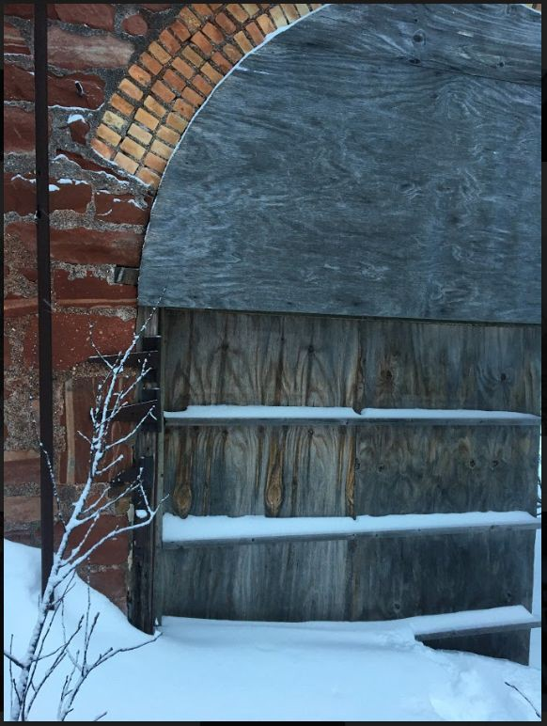
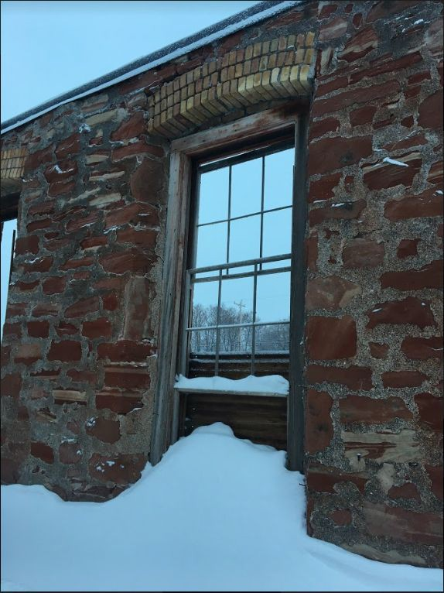
Doors and Windows
Some existing window frames.
Mostly in poor shape.
Reid

Slide 24
Landscaping and Parking
A parking lot with a maximum capacity of 40 vehicles will be located directly opposite (south) of the structure from US 41 with access from Lower Pewabic Road.
A small road will connect the lot to Lower Pewabic Road.
A 5 foot wide gravel walking path will be laid over a sand subbase from the parking lot and will wrap around to the front entrance of the structure.
Connor

Slide 25
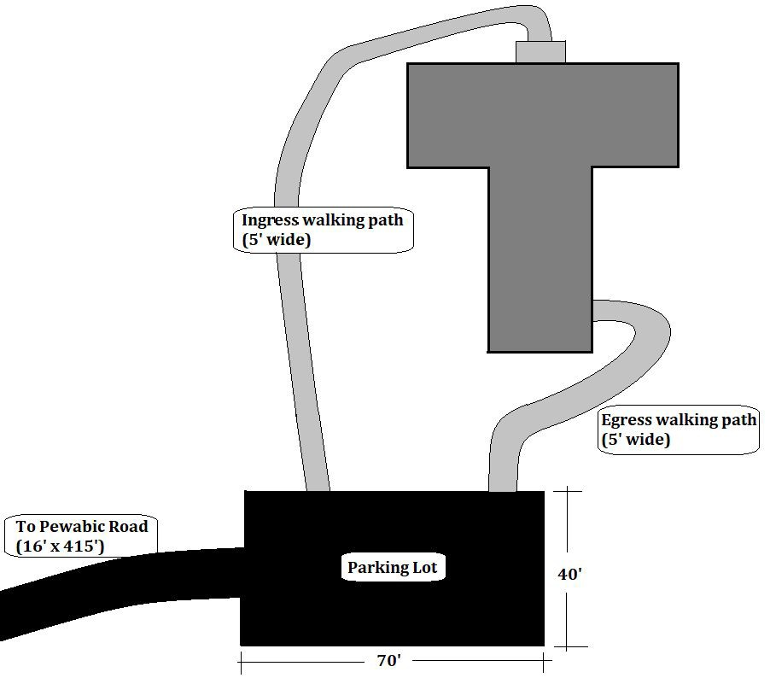
Landscaping and Parking Design
70’ x 40’ parking lot
5’ wide walking path (ADA compliant)
16’ x 415’ access road
Connor

Slide 26
Cost Estimate Summary
Glulam Beams | $156,300.00
Clearing | $4300.00
Floor | $37,600.00
Loft | $21,500.00
Windows & Doors | $44,000.00
Roof | $272,200.00
Exterior Improvements | $28,700.00
General Requirements | $10,300.00
10% Contingencies | $57,500.00
Approximate Total: | $632,400.00
Estimates:
  Diﬀerent suppliers
  The 2017 RS Means.
Estimate includes Overhead and Proﬁt.
Rayni

Slide 27
Construction Schedule - Overview
The project will be split into four phases that will be suitable for the client’s funding.
The ﬁrst phase will enclose the structure to protect the building from any wear and as a result the Quincy Mine Hoist Association can complete the following phases as they please.
Each phase will have a duration of between 1 and 2 months.
The early phases will prioritize preparing the jobsite and closing up the roof of the structure.
In total the project, if completed in a continuous manner, would have a total duration of approximately 106 days
Connor

Slide 28
Construction Schedule - Constraints
Available funding and other projects will dictate the total duration of the project.
As a result of phasing the project, the construction equipment will have to be demobilized and remobilized for each phase.
The acquisition of the proper permits, insurance, and bonds shall occur at least 30 days prior to the commencement of phase one.
Project closeout can commence as the construction of the permanent parking lot and walking path begins as the project will be substantially complete at this point.
Connor

Slide 29
Construction Schedule - Phasing
Prior to the start of construction all of the proper bonding, permitting, and insurance will need to be acquired.
The ﬁrst phase of the project will include the clearing and grading of the project site and building interior as well as the construction of the roof and loft.
The S.O.G. in the interior of the Drill and Blacksmith shop will be constructed in phase two.
The ﬁnal enclosing of the structure (including windows, doors, and weatherprooﬁng) will take place in phase three as well as the construction of the entire oﬃce structure.
Phase four will consist of landscaping and the permanent parking lot construction.
Connor

Slide 30
Thank You!
David Nelson
Dr. Tess Ahlborn Glenda Bierman John Sullivan
The Quincy Mine Hoist Association Michigan Tech Archives

Slide 31
Questions

